Slide 1
IOT Platform
2024

Slide 2
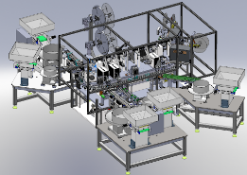
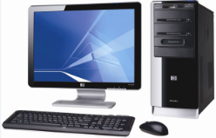
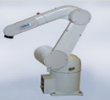
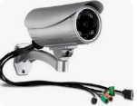
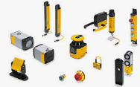
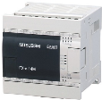




IOT Platform
Application Implement
Operation layer
Management layer
Decision layer
Smart Factory Platform
Assess Management System (TMS/DMS)
Quality Control
(IT SFC&AllPart Integrated)
Data Output
Web services
REST API
Information
Center
Data Processing, ETL, Analytic
PHM, CPK, SPC
Storage
(Data Warehouse, Big Data Model)
Parts, Consume Usage Monitoring
PDCA
Machine FAI
Online Location Management
Call for repair
Machine Maintenance Schedule
Data Collection Module
IT Isolation Network
Modules Category
IOT Device Register/ Heath Check
Fii IOT Local Data Collect Terminal
Automation
Tester
Robot Arm
Camera
Basic Physical Data
Sensors
PLC
Log File
Database
Media

Slide 3

IOT Platform - Infrastructure
各單位有自己抓取資料平台以及相應的APP
Fii
Fii Web Server:
统一登录，权限管控
负责连接各BU的DB数据库
應用開發與展開
BU IOT Server:專門資料儲存
按照數據表Schema建立對應數據表
開通訪問權限給Fii系統登錄呈現資料
CBD
JBD
MBD
CBD Ring/Apollo Infrastructure (For Reference)
Data Collection Server
Database Server
BU IOT Server
IT Isolation Network
Online Machine

Slide 4
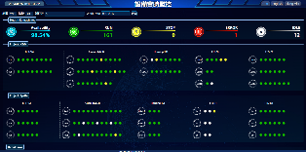
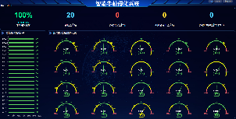
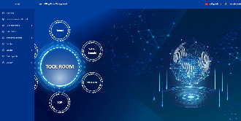
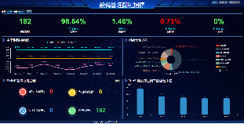
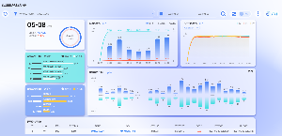
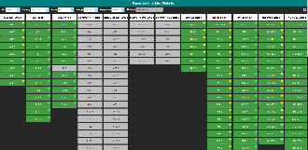
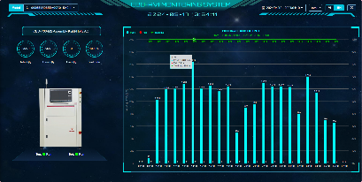
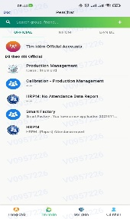
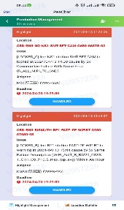
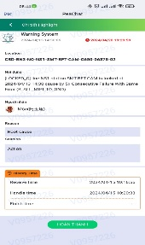
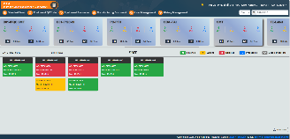
Standard Applications Deploying Plan
Phase 1
(Data Collection)
Phase 2
(Data Analyze)
Phase 3
(Machine Management)
Machine Real-Time Monitoring
Machine KPI Management
AVI Machine Monitoring (Optional)
PHM
LLM
Auto Call Repair
Assess/Consume Management
Maintenance Schedule
Machine FAI Quality Control

Slide 5
IoT Platform Cut-in Plan
CBD Ring/Apollo
CBD Solo/Vantiva/LandysG
JBD
MBDI
MBDII
# | Item | BU/CFT | CBD |  |  |  | JBD | MBDI | MBDII
 |  |  | Ring/Apollo | Solo | Vantiva | LandysG
 |  | BU Head | Michael Wang | Adolph Siao | Ian Chen | Mike Gao | David Yin | DaiXin Gao | DaiXin Gao
 |  | BU Owner | Bella/Young | 阮才康
1 | Hardware | Database Server & Collect Data Server | V
2 |  | Server Connectivity （Database connection） | V
3 |  | Database setup | V
4 | Data Collection | Cut-in Plan | V
5 |  | Data type by machine list (Status, Availability Rate, Error by Time…) | V
6 |  | Machine error list definition list | V
7 |  | Collect data develop plan | V
8 | Application Deploying | Server Web at Fii Server | V
9 |  | Data storage at BU Server | V
10 |  | Install program at Local PC
11 | Maintenance | Database Backup Plan | V
 |  | Information Security Control | V
12
 |  | Server Operation Monitoring | V
13
14 |  | Data Collecting Monitoring | V
 |  | Upgrade Terminal Data Program for new type of data | V
15

